Slide 1
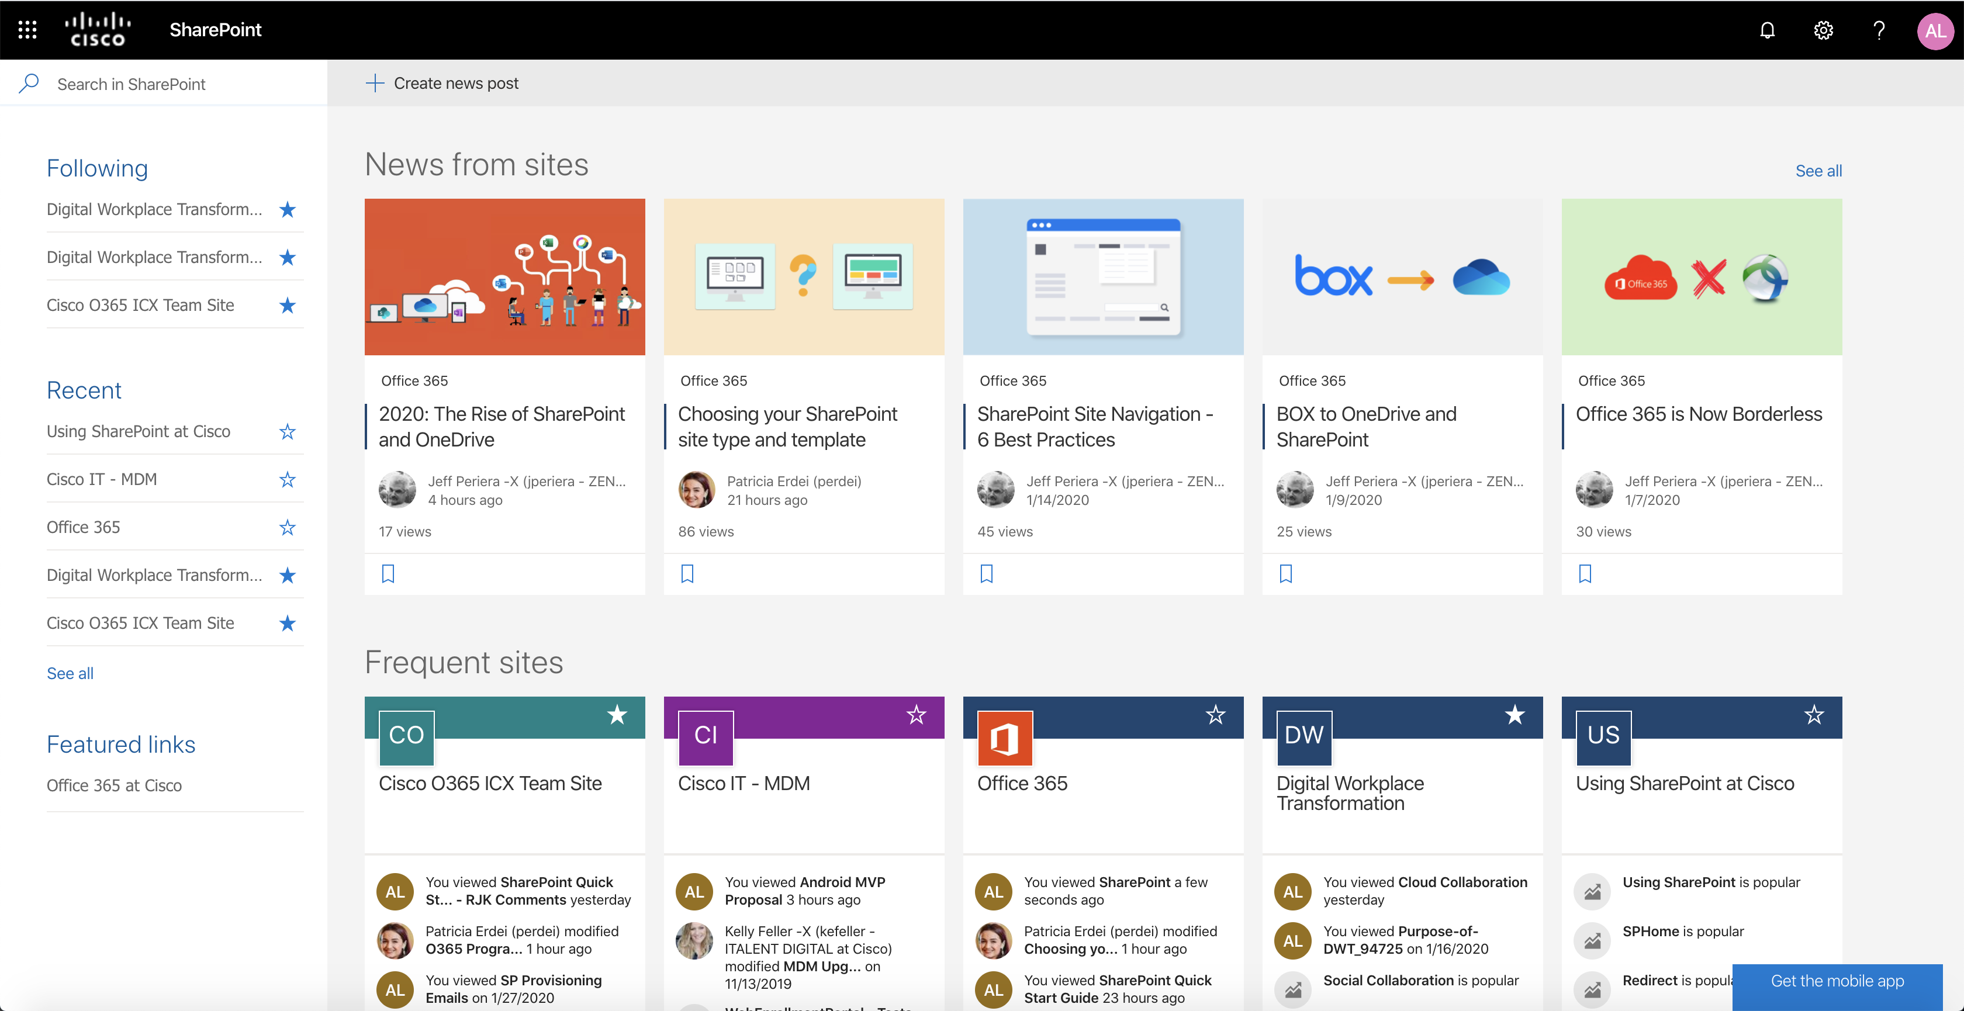
Quick Start Guide
Sign in to your Office 365 subscription and select SharePoint from the App Launcher.
Create a News Post
You can publish eye-catching posts like announcements, people news, status updates, and more in any site you have permissions to.
Search
Find Sites, People, or Files.
Find Your Sites
Following displays sites you follow, like your team’s site or a site from another group you work with.
Recent shows any site you’ve gone to recently.
Featured links display sites your company wants to showcase.
Check Out Featured Content
News from sites highlight updates from sites you follow or visit often.
Frequent sites show sites you like to go to and recent activity in them.

Slide 2
SharePoint Site Request Process
Search: Reference the SharePoint Site Directory to determine if your intended Team or Communication Site already exists. If it does exist, please contact the listed site owner (primary site admin) to access said SharePoint site. Duplicate Site Requests will be denied.
Understand: Read through the Choosing your SharePoint site and template. This document will provide you with additional instructions to create your SharePoint site.
Request: Submit a New SharePoint Site Request in Cisco eStore. The review process can take up to 3 days. Once provisioned, you will receive a confirmation email.
Learn: Read through this Quick Start Guide and attend our bi-weekly SharePoint Learning Sessions.
Team Sites vs. Communication Sites
Team sites are designed to connect teams with specific content, documents, projects, and tools they need to collaborate. The Team site will have less members and more editors to co-author documents.
“We want to collaborate on a project.”
Communication sites are designed to broadcast messages, tell stories, share content, or showcase services or people. The Communication site will have many members and limited editors to edit content, information, and news that audiences will consume and view.
“We would like to publish our own content.”
To help teams adhere to Cisco branding standards, communication sites come with 4 layout options: general template, showcase template, topic template, and blank template. Team sites do not have layout templates.
Important: Once you have chosen your site type/template and submitted your request in eStore, your decision cannot be reversed (i.e. you cannot switch site types).

Slide 3
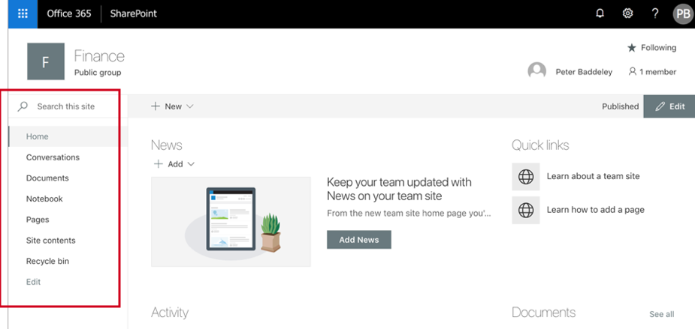
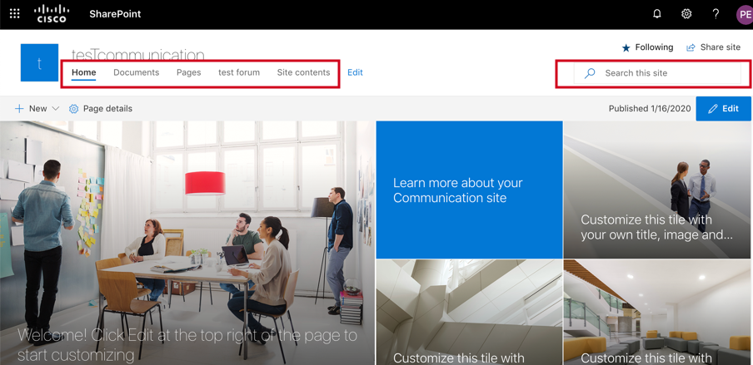
SharePoint Site Planning
These are six essential questions for you to answer before you start designing your SharePoint site.
What site type do I need and what will it look like? (Team Site vs. Communication Site? For Communication Sites, which template?)
Who will use the site and who has access to the site ? (Intended Audience, Site Permissions/Sharing)
How will employees and groups use the site? (Site Content/Navigation)
Who will maintain the site? (Site Governance, Content Publishing)
Site Recommendations If you've already chosen what type of SharePoint site you want, you'll likely have a good idea of who your intended audience is and which template your site will have (if it’s a Communication site).
In order to access and adjust your Site Permissions, click on Settings and then select Site Permissions. External sharing in SharePoint is currently unavailable.
On a Team site, the navigation will be vertical, and placed on the left side of the site, like in a library. On a Communication site, the navigation will be horizontal, and placed above your site content, across the page, like on a modern website. To learn about standard site navigation practice, refer to Microsoft’s Planning Navigation Guide.
SharePoint site policies define the life-cycle of a site by specifying when the site will be closed and when it will be deleted. You must activate the Site Policy feature before it appears on the Site Settings page. To learn about site policies, refer to Microsoft’s Site Closure & Deletion Guide.

Slide 4
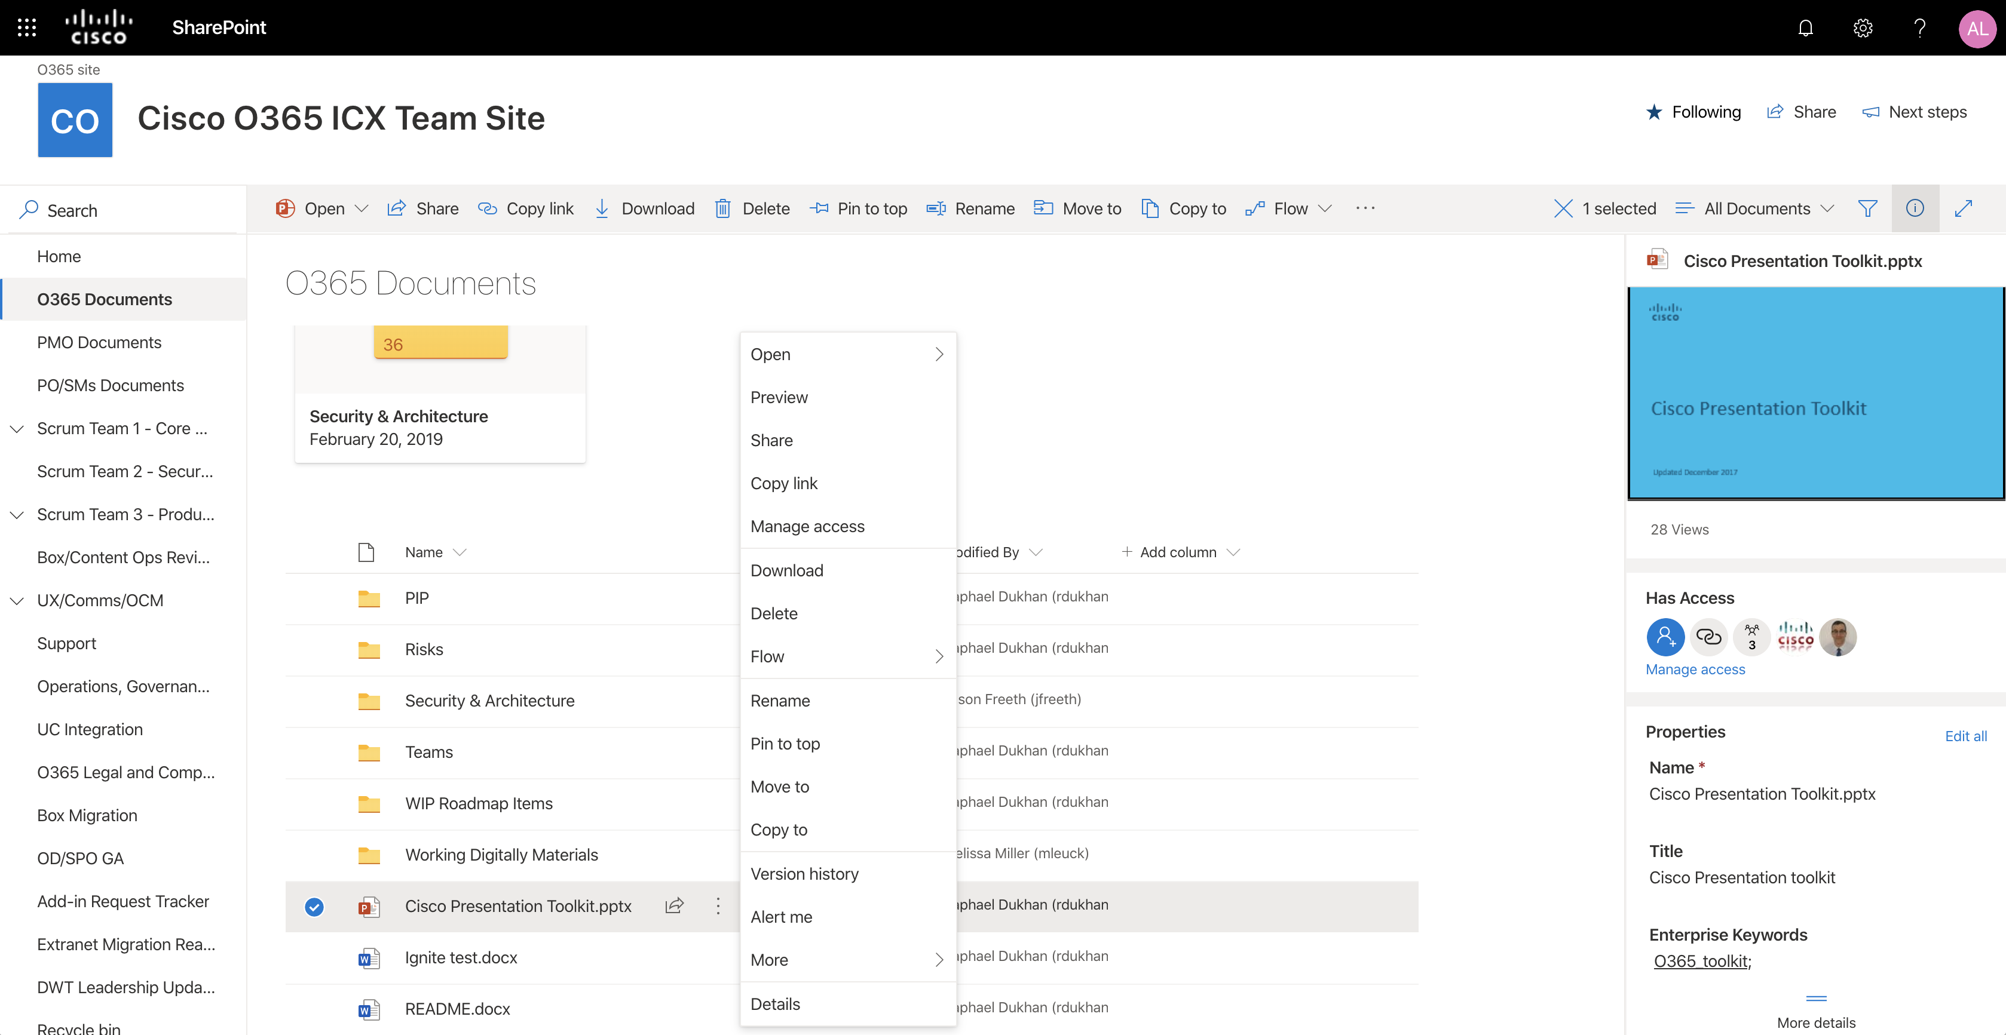
Work with files in Team sites
Select a Team Site from the SharePoint homepage or enter its URL into your browser. Then select Documents in the left navigation pane.
Open
Open and edit a file online or in a desktop application.
Share
Share files directly from SharePoint. Files are private until shared.
Copy Link
Get a link to the selected file to insert in an IM, email, or site.
Move To/Copy To
Move or copy to another destination in your OneDrive or any SharePoint Site.
Details Pane
See file information, a thumbnail, recent activity, manage access permissions, and edit file properties.
Documents
View and work with the files stored on a SharePoint site.
Download
Download a copy of a file to work offline that takes local device space.
Sharing Status
See which files are being shared and who they’re shared with.
Flow
Automate common tasks between SharePoint and other Office 365 and third-party services.
Pin To Top
Pin important folders or documents to the top of the list for easy viewing.
Version History
View a file’s version history and restore a file to a previous version.

Slide 5
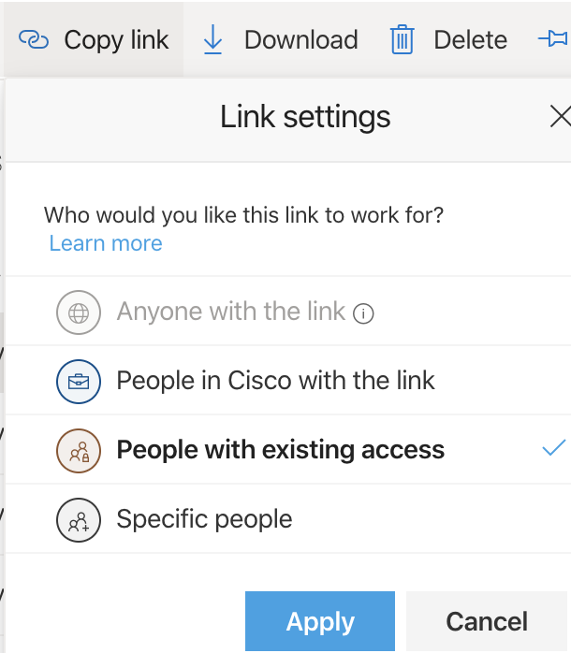
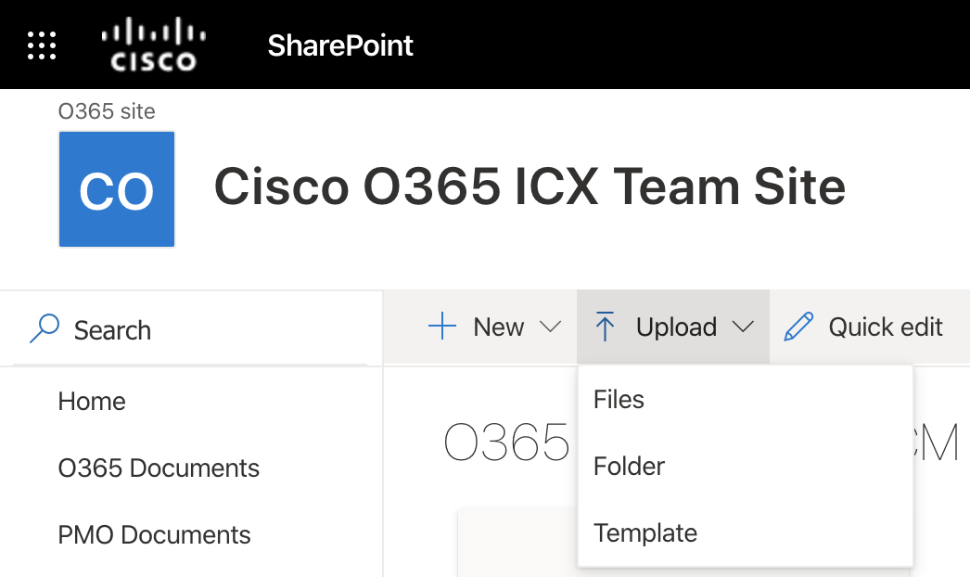
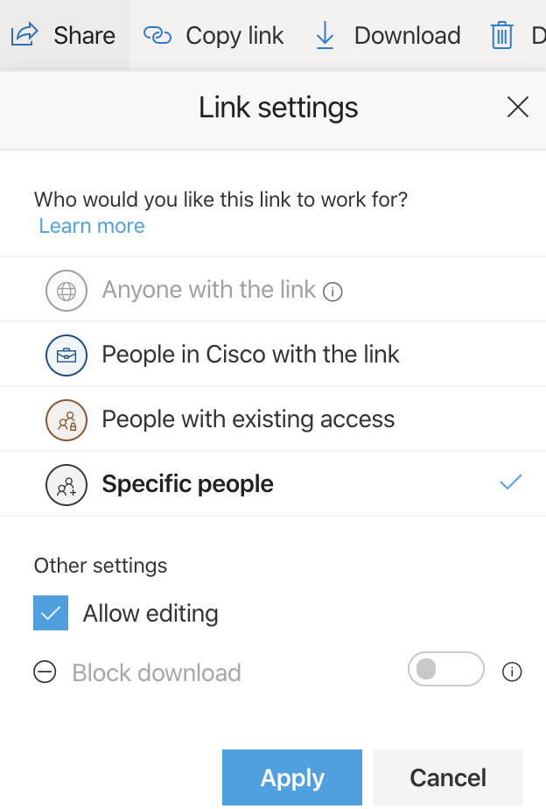
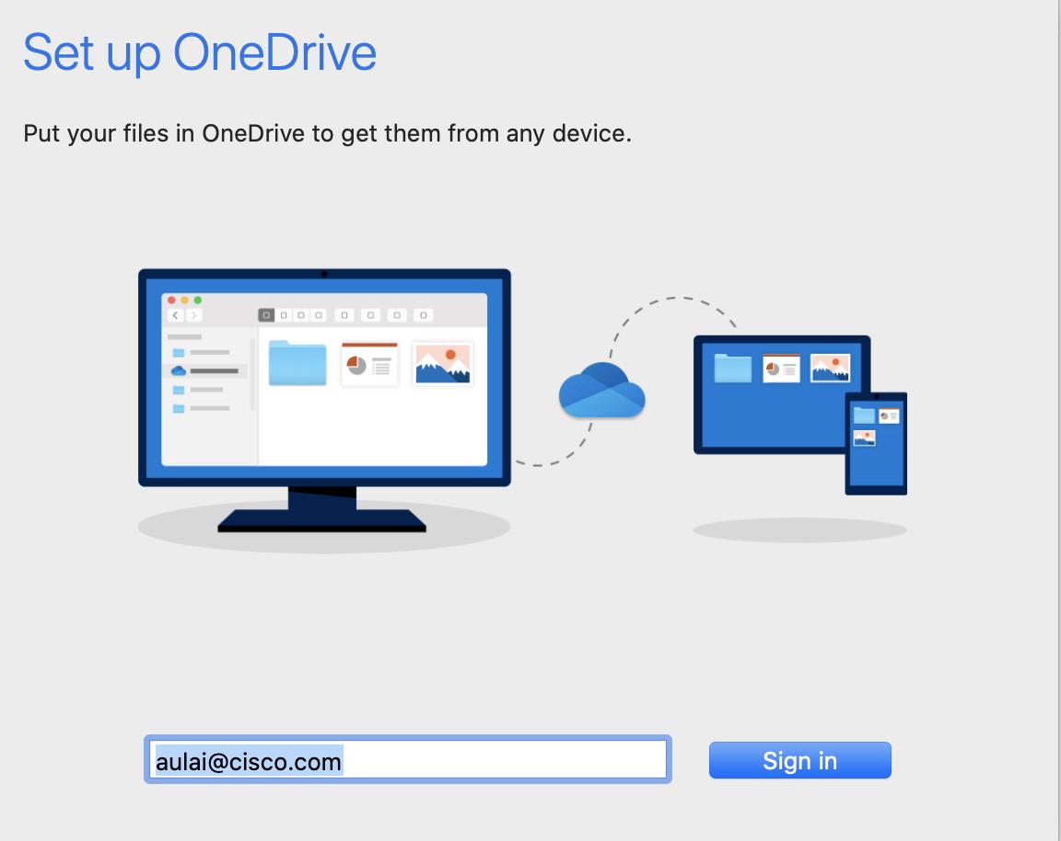
Create/Upload Files and Folders
Copy Link
You can create new files and folders and upload existing files and folders from your device. Select Upload > Files or select a location in SharePoint and drag/drop files and folders from your device.
You can also share a file or folder by copying the link. Select a file and select Copy Link.
Share Files
Sync SharePoint Files and Folders with OneDrive
Select a file and select Share. You can grant Edit or View permissions for recipients.
Select Sync from a document library and sign in to sync your files and folders in SharePoint to your computer through OneDrive. Offline access is granted.

Slide 6
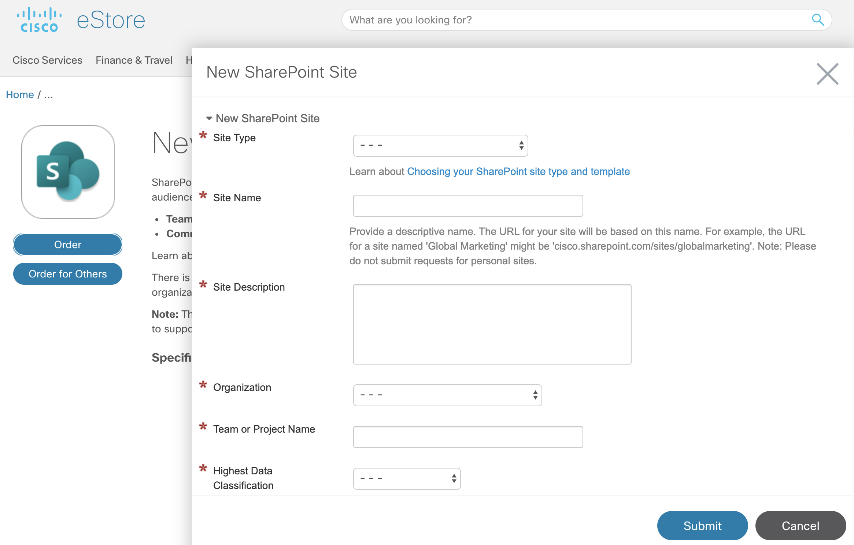
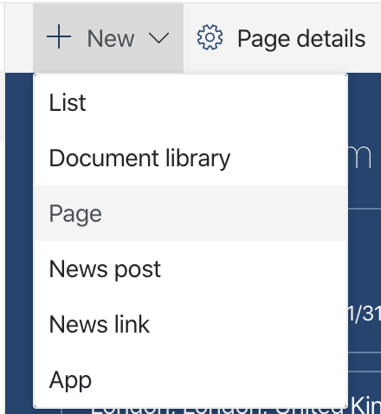
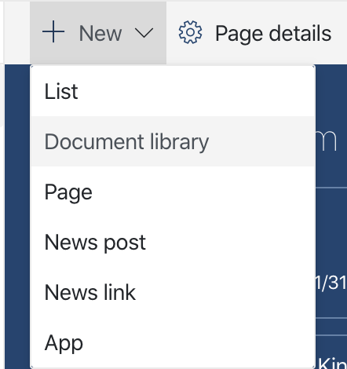
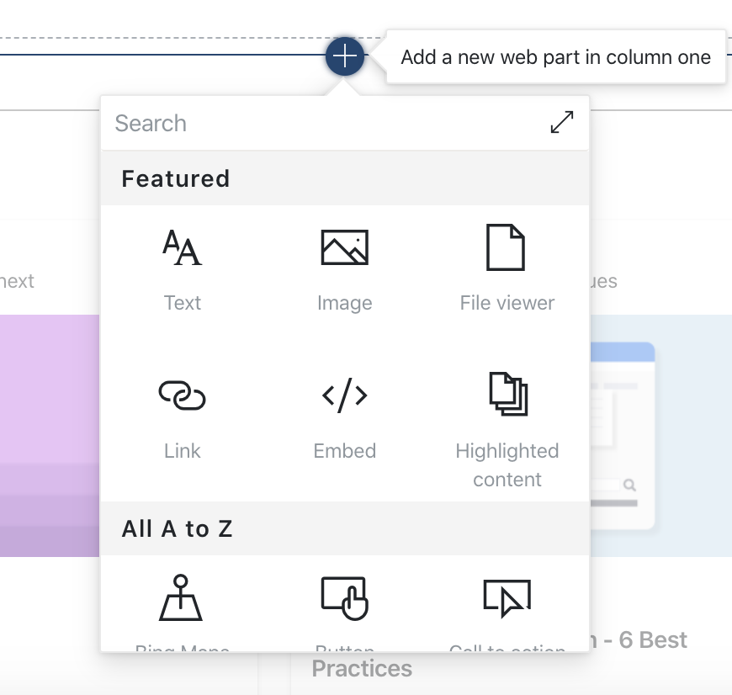
Create a Site
Share Files
Submit a request for a Team Site or Communication Site in Cisco eStore and the SharePoint Online Site Requests Team will review and create your SharePoint site.
Select + New > Page in your new site, name your page, and select Publish.
Add a Document Library or List
Add Web Parts
Select + New in your new site to add a library or list.
In edit mode, select the plus sign (+) in your news post or page. You can add text, images, files, video, dynamic content, and more by using the corresponding web parts.

Slide 7
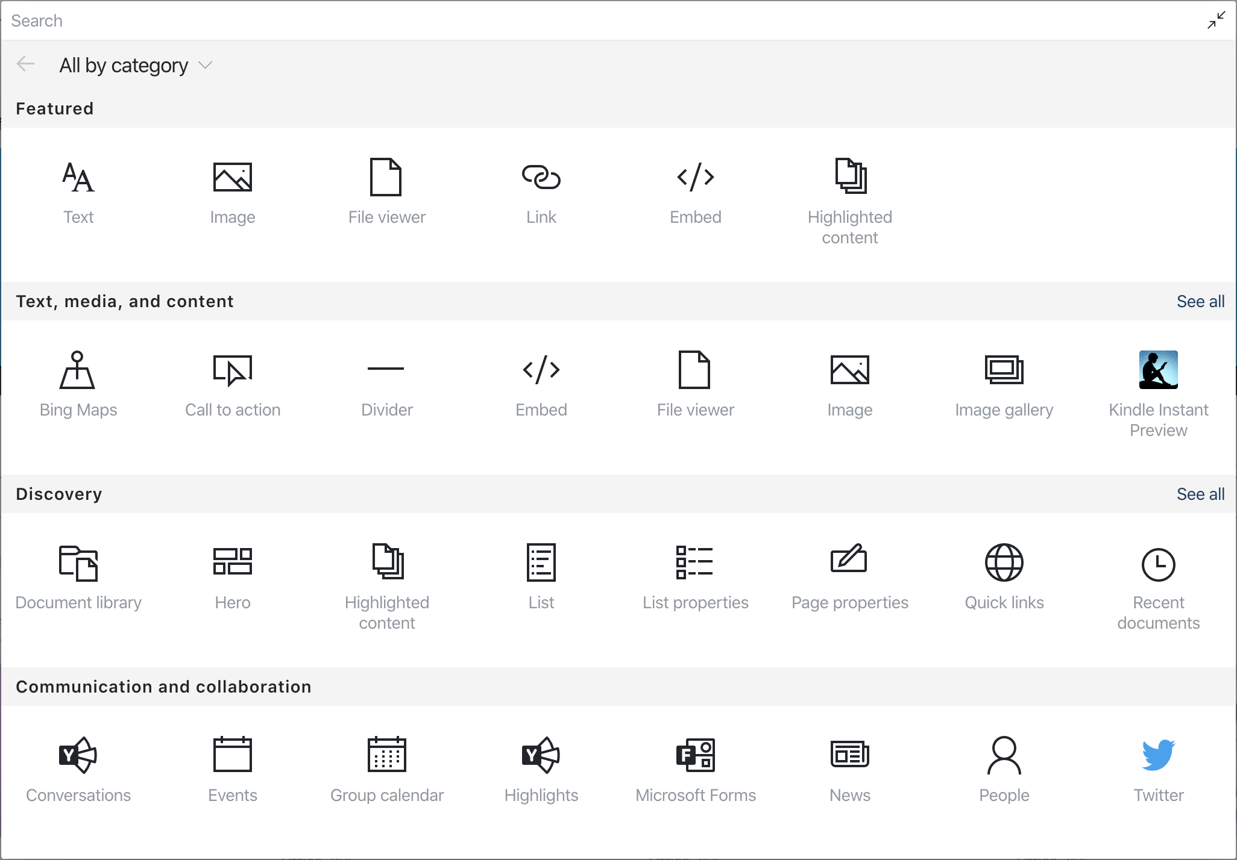
Web Parts
Web parts are customizable building blocks for your SharePoint site page. You can add text, images, files, video, dynamic content, and more.
Here are some commonly used web parts.
Text
Add text and tables to your page.
Image
Add an image from a library, upload a new one, or search for one online.
Link
Use the Link web part to add a link with a preview to internal or external content.
Embed
Enrich your page by displaying content from other sites.
Highlighted content
Dynamically display content based on content type,
filtering, or a search string.
File viewer
Insert a variety of different file types on your page.

Slide 8
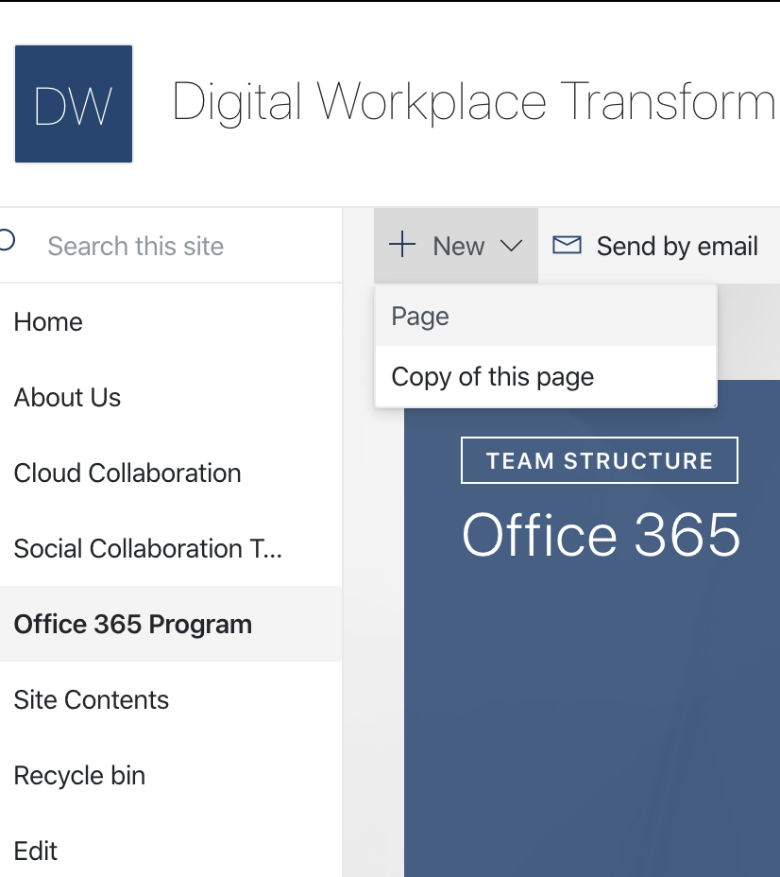
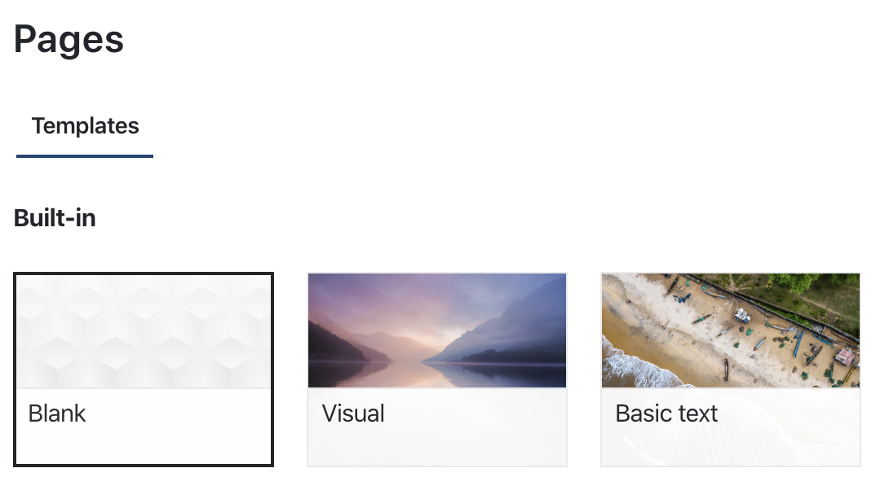
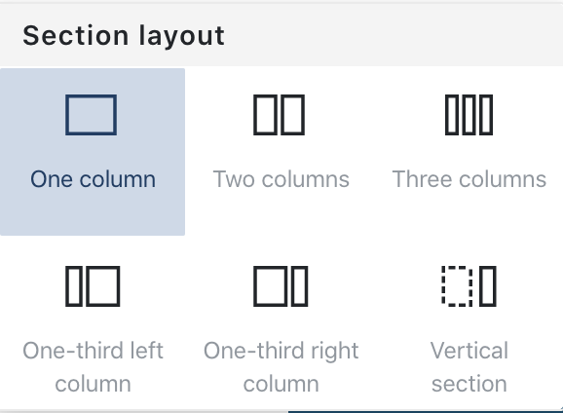
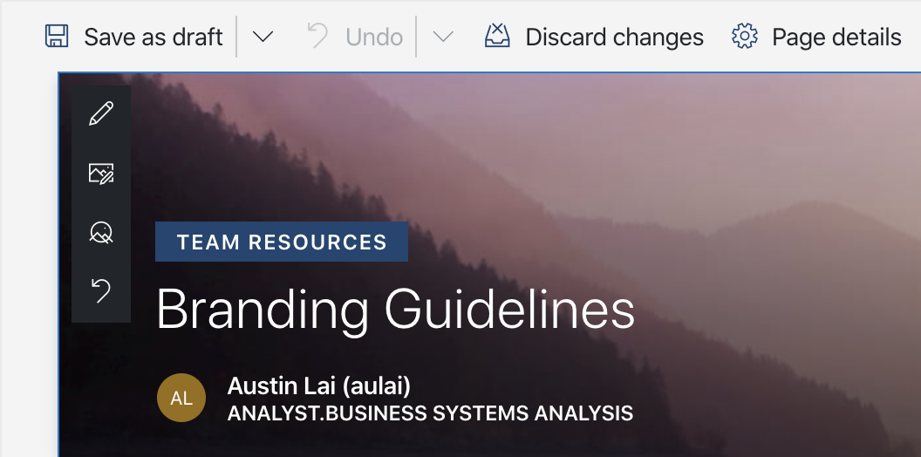
Cisco-Branded Site Themes
A
B
C
Click on New > Page.
You can add a page title and image.
Click the + icon on the left to add sections and columns.
Publish Users on the site won't see the page until you publish it. Published pages are viewable by users who have appropriate site permissions.

Slide 9
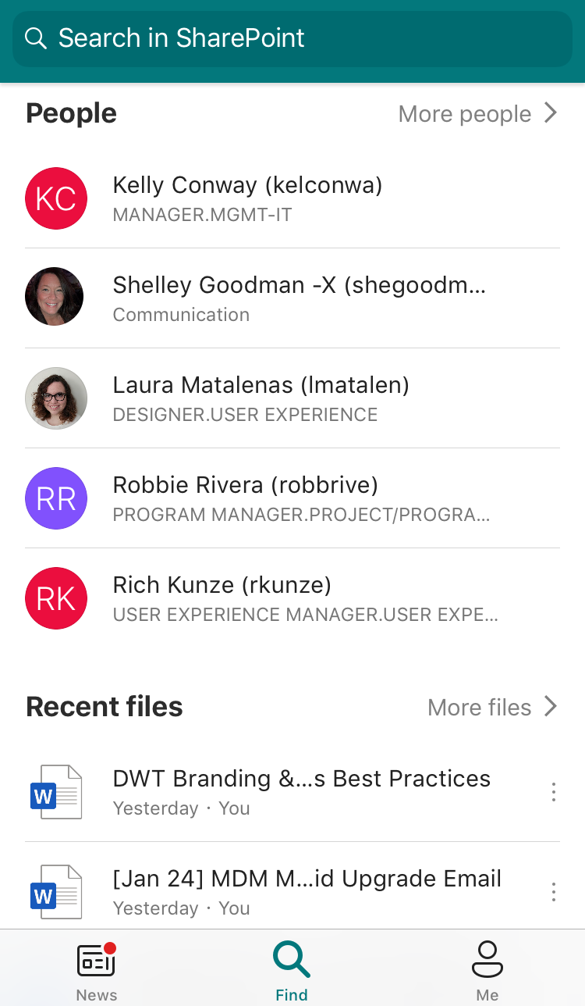
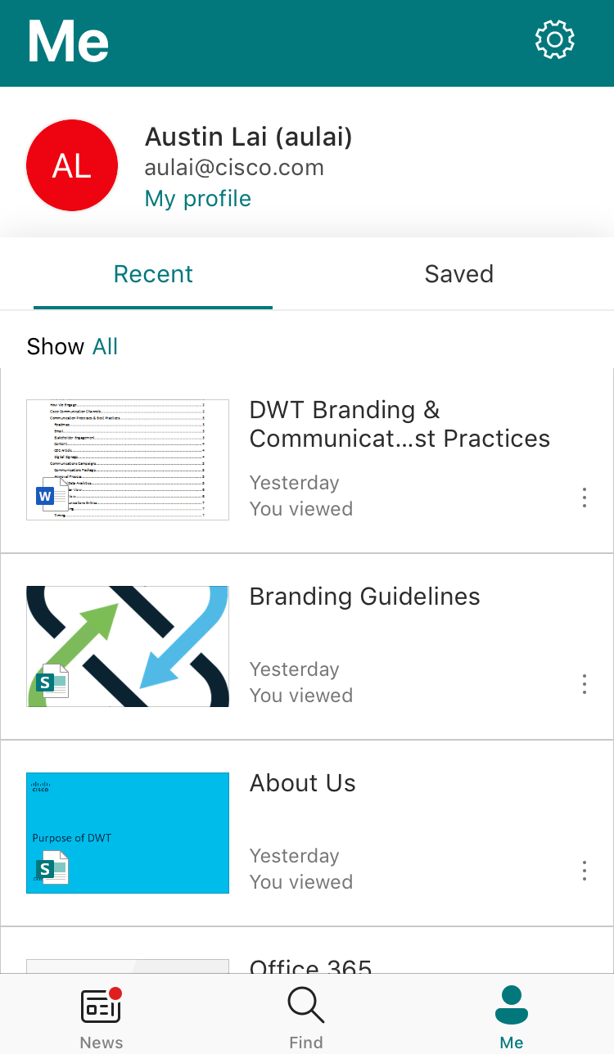
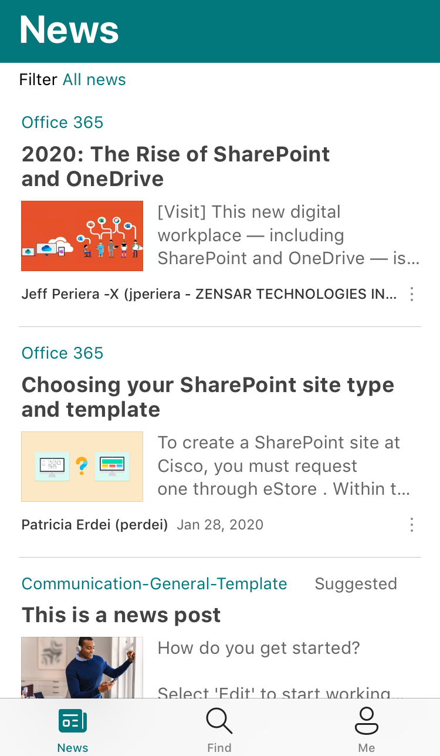
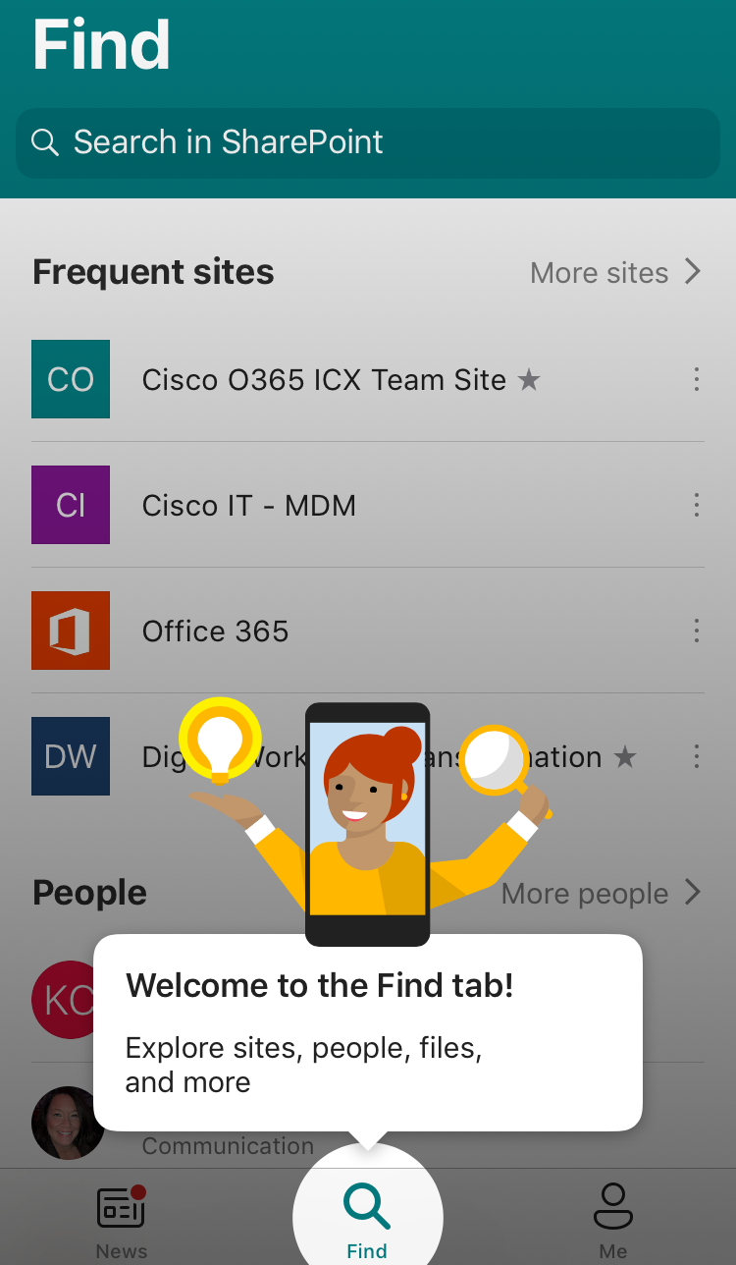
Mobile SharePoint Access
Mobile SharePoint is a new way to reach intranet content on your phone or tablet and is available to download in Cisco eStore for iOS, Android, and Windows. You can access sites, people, and files, search and browse SharePoint, stay up-to-date with news, and view your content without VPN access.
Tap on a user to access their contact card, see who they work with, and what they are working on.
Access your personalized view of team sites, communication sites, and news posts.
View news posts on the go and share your updates, reports, status, and experiences with your team.
Browse your sites, files, people, and more.
Search to find and discover important content.

Slide 10
Next Steps
Read About SharePoint’s Frequently Asked Questions In case you have additional questions about SharePoint, please reference the SharePoint FAQ’s in the Office 365 Communication Site.
Attend a SharePoint Site Owner Training Session The Cisco Office 365 Team offers bi-weekly SharePoint Team Site Owner and SharePoint Communication Site Owner Training Sessions.
Get Mobile SharePoint Download Mobile SharePoint through Cisco eStore for iOS, Android, and Windows. No VPN access is required.
Happy Designing! If you would like to provide feedback/comments on this training guide, please contact O365-SharePoint-Team@cisco.com.

